Slide 1
TRANSLATION OF mRNA
GROUP 3
Notes:
we’ll dive deeper into the specific molecular interactions involved. Recent research by geneticists, cell biologists, and biochemists has greatly improved our understanding of translation, but many questions still exist, making it an exciting area for ongoing research. In this chapter, we’ll start with classic experiments that showed some genes encode proteins that act as enzymes. We’ll then look at how the genetic code helps translate mRNA into a polypeptide with a specific amino acid sequence. The rest of the chapter will focus on the details of translation in living cells.We’ll examine the important components needed for translation, including the structure and function of tRNA, which helps translate genetic information, and the composition of ribosomes. Finally, we’ll explore how translation occurs in both bacterial and eukaryotic cells.

Slide 2
GENETIC BASES FOR PROTEINS SYNTHESIS
Proteins are essential for cell structure and function.
The primary role of DNA is to store information necessary for protein synthesis.
Genes encoding amino acid sequences are called STRUCTURAL GENES..
RNA transcribed form structural genes is known as mRNA.
The main function of genetic material is to encode proteins correctly-ensuring they are produced in the right cells, at the right time, and in appropriate amounts.
Cells produce thousands of different proteins: bacteria make a few thousand, while eukaryotes produce several to tens of thousands.
Early experiments helped establish that genes encode proteins.
The genetic code translates mRNA nucleotide sequences into amino acid sequences for protein production.

Slide 3
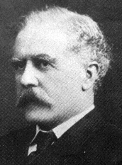
ARCHIBALD GARROD
Archibald Garrod, a British physician, first suggested a relationship between genes and protein production in the early 20th century.
Biochemists had already studied metabolic pathways in cells, where each step in these pathways is catalyzed by a specific enzyme.
Each enzyme is a distinct protein facilitating a particular chemical reaction.
Garrod studied patients with metabolic defects, especially focusing on alkaptonuria, a disease causing abnormal homogentisic acid buildup.

Slide 4
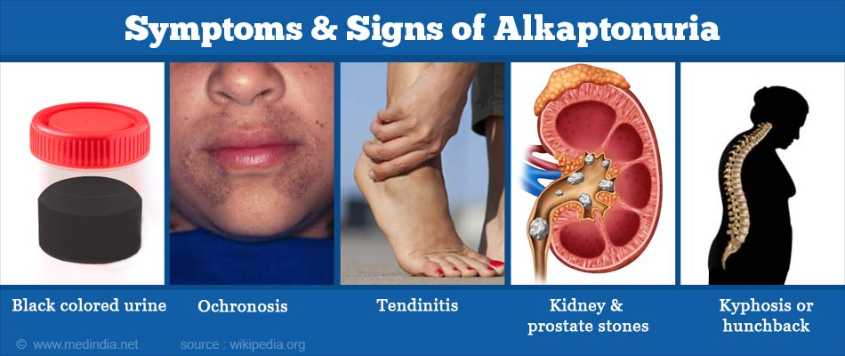
Alkaptonuria is marked by black urine and bluish-black skin/cartilage discoloration.

Slide 5
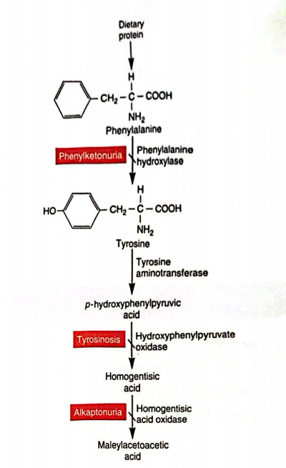
Garrod proposed that alkaptonuria resulted from a missing enzyme, homogentisic acid oxidase, due to a genetic defect.
He observed that alkaptonuria follows a recessive inheritance pattern.
Garrod’s hypothesis linked inherited genetic defects to enzyme deficiencies, coining the concept of “inborn errors of metabolism.”
His idea was groundbreaking as it proposed a connection between genes and enzymes when the nature of genetic material was unknown.
Figure 13.1 Example of Enzymatic Action

Slide 6
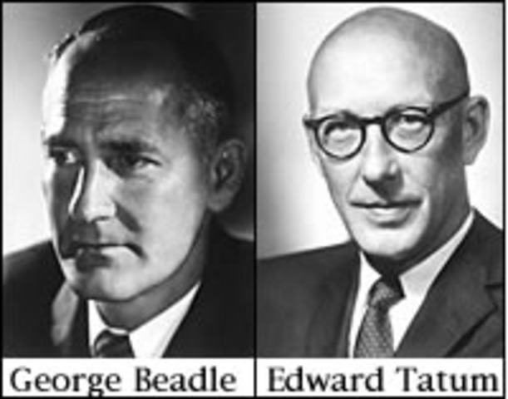
Experiments with Neurospora LED them to propose the One Gene-One Enzyme Theory
In the 1940s, George Beadle and Edward Tatum investigated the relationship between genes, enzymes, and traits.
They developed an experimental system to study how genes control enzyme production.
Their assumption, consistent with Garrod, was that genes are related to enzyme production, but they questioned whether one gene controlled one or many enzymes.
Many geneticists were studying complex traits, but Beadle and Tatum focused on simple nutritional requirements in Neurospora crassa (bread mold).

Slide 7
Experiments with Neurospora LED them to propose the One Gene-One Enzyme Theory
Neurospora grows easily on minimal medium with a carbon source, inorganic salts, and biotin, and synthesizes its own amino acids and vitamins
Beadle and Tatum hypothesized that a gene mutation causing an enzyme defect would prevent growth on minimal medium but could be restored by supplementing the missing nutrient.
They irradiated over 2,000 strains and found three mutant strains that couldn’t grow on minimal medium but grew when supplemented with specific vitamins (pyridoxine, thiamine, and p-aminobenzoic acid).
Each mutant had a defect in a gene that prevented the synthesis of an enzyme necessary for vitamin production.
Beadle and Tatum concluded that a single gene controls the production of a single enzyme, forming the one gene-one enzyme theory.

Slide 8
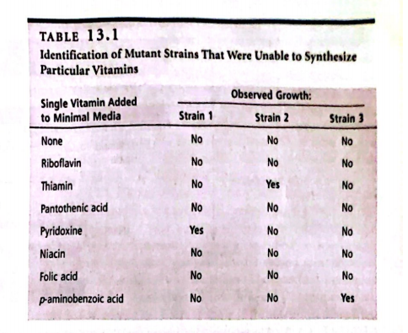
Experiments with Neurospora LED them to propose the One Gene-One Enzyme Theory

Slide 9
Experiments with Neurospora LED them to propose the One Gene-One Enzyme Theory
The theory was later modified:
Enzymes are only one type of protein; all proteins are encoded by genes.
Some proteins consist of multiple polypeptides, so a single gene encodes a single polypeptide.
A protein denotes function, while a polypeptide denotes structure.
Example: Hemoglobin, composed of two α-globin and two β-globin polypeptides, requires the expression of two different genes.
Notes:
First, not all proteins are enzymes; many proteins have other functions. Second, some proteins are made of multiple polypeptides. Therefore, it’s more accurate to say that each structural gene encodes a single polypeptide, which is a chain of amino acids. A protein can consist of one or more polypeptides. For instance, hemoglobin consists of two alpha and two beta globin polypeptides, meaning two different genes are needed to produce this functional protein.

Slide 10
During Translation, the Genetic Code Within mRNA Is Used to Make a Polypeptide with a Specific Amino Acid Sequence
Translation Process: Interprets mRNA (nucleotide sequence) into proteins (amino acid sequence).
Genetic Code: mRNA sequence is read in groups of three nucleotides, called codons, which specify amino acids.
Codons: Each codon represents a specific amino acid (e.g., CCC = proline, GGC = glycine, AUG = methionine).
AUG serves as the start codon, and UAA, UAG, UGA are stop codons.

Slide 11
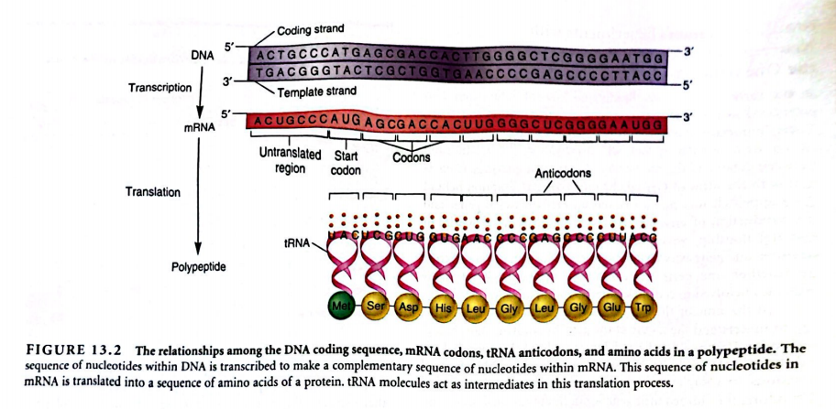
During Translation, the Genetic Code Within mRNA Is Used to Make a Polypeptide with a Specific Amino Acid Sequence

Slide 12
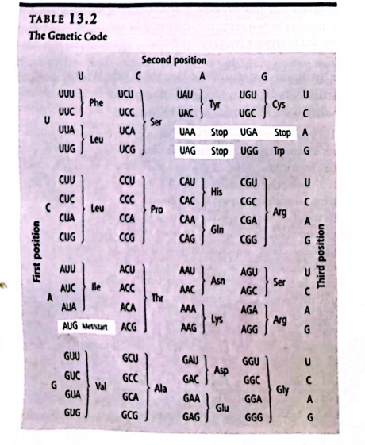
During Translation, the Genetic Code Within mRNA Is Used to Make a Polypeptide with a Specific Amino Acid Sequence
Degenerate Code:
There are 64 possible codons, but only 20 amino acids, meaning multiple codons can encode the same amino acid.
Example: GGU, GGC, GGA, and GGG all specify glycine.
The third base in a codon is often called the "wobble base.".

Slide 13
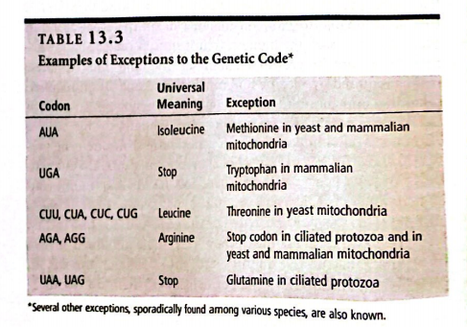
During Translation, the Genetic Code Within mRNA Is Used to Make a Polypeptide with a Specific Amino Acid Sequence
Universality of the Genetic Code:
The genetic code is nearly universal across species, with few exceptions like mitochondrial DNA.
Mitochondrial differences include AUA encoding methionine and UGA encoding tryptophan.

Slide 14
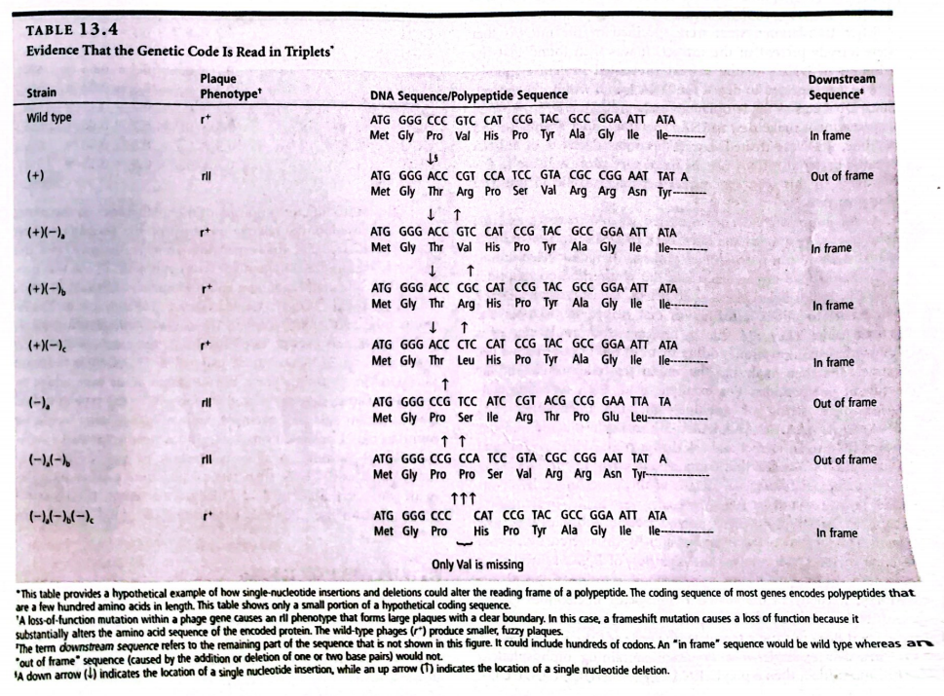
During Translation, the Genetic Code Within mRNA Is Used to Make a Polypeptide with a Specific Amino Acid Sequence
Crick's Experiments (1961): First evidence for triplet codons came from Francis Crick's experiments with T4 bacteriophage mutations.
Single-nucleotide mutations (additions/deletions) caused frameshift mutations.
Mutations that restored the original reading frame led to nearly normal protein function.
Combining three (-) mutations restored the wild-type, suggesting the genetic code is read in triplets.

Slide 15
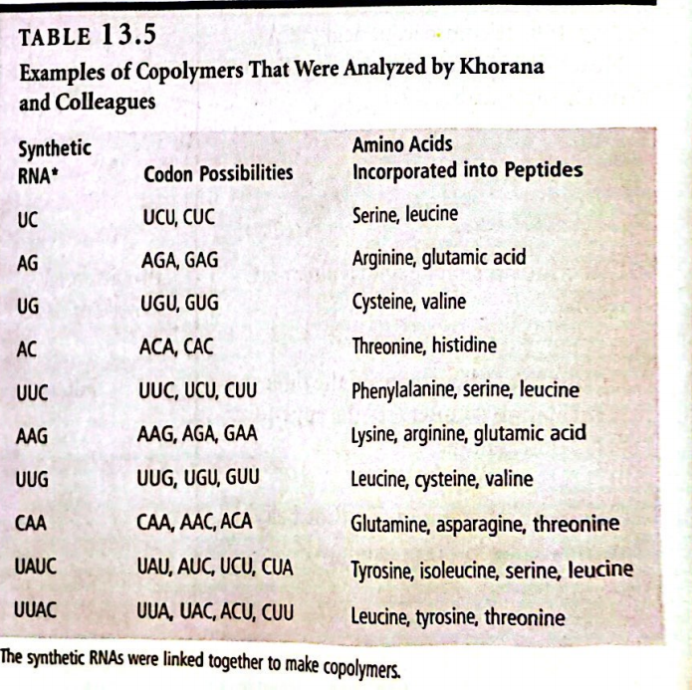
THE USE OF RNA COPOLYMERS AND THEIR TRIPLET BINDING ASSAY ALSO HELPED TO CRACK THE GENETIC CODE
H. Gobind Khorana's RNA Synthesis Method (1960s):
Developed a method to chemically synthesize short RNA molecules (2-4 nucleotides).
These short RNA sequences (e.g., 5'-AUC-3') were enzymatically linked to create long RNA copolymers (e.g., 5'-AUCAUCAUCAUCAUCAUCAUC-3’).
Copolymers contained multiple codons (AUC = isoleucine, UCA = serine, CAU = histidine).
When tested in a cell-free translation system, these copolymers produced polypeptides containing specific amino acids (e.g., isoleucine, histidine, serine).

Slide 16
THE USE OF RNA COPOLYMERS AND THEIR TRIPLET BINDING ASSAY ALSO HELPED TO CRACK THE GENETIC CODE
Marshall Nirenberg and Philip Leder's Triplet Binding Assay (1964):
Discovered that RNA triplets (three nucleotides) could stimulate ribosomes to bind tRNA.
RNA triplets functioned as codons, allowing tRNA with the matching anticodon to bind.
The relationship between specific triplet sequences and amino acids was established by using ribosomes, triplets, and tRNAs with radiolabeled amino acids.
Example: The 5'-CCA-3' triplet promoted binding of tRNA carrying radiolabeled proline.
Radioactivity was measured to determine which amino acid corresponded to a specific triplet sequence.
The triplet binding assay identified most codons, though some triplets yielded ambiguous results due to insufficient tRNA binding.

Slide 17
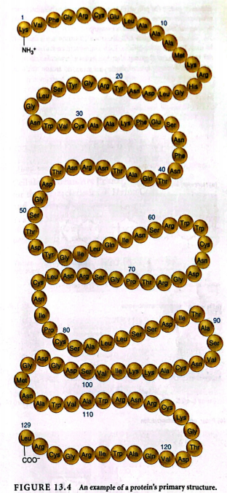
AMINO ACID SEQUENCE OF POLYPEPTIDES DETERMINE THE STRUCTURE AND FUNCTION OF PROTEINS
After gene transcription and mRNA translation, the result is a polypeptide with a defined amino acid sequence, called the primary structure.
The primary structure determines how the polypeptide folds into its three-dimensional structure.
Amino acid side chains' chemical properties play a central role in protein folding.
Hydrophobic amino acids are buried inside the protein, while hydrophilic amino acids tend to be on the surface, interacting with water.

Slide 18
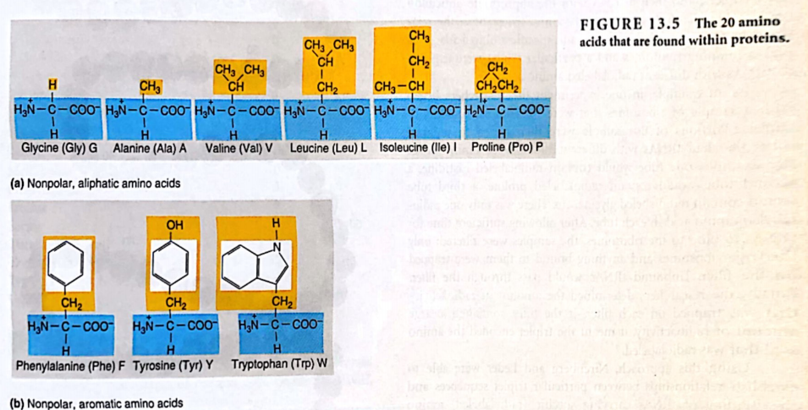
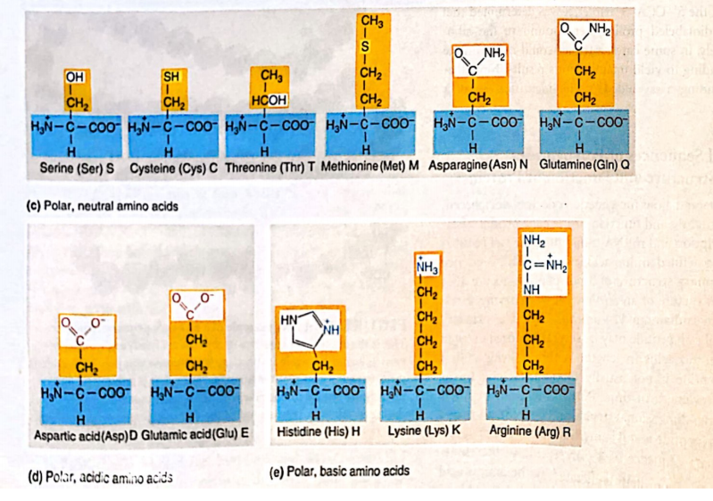

Slide 19
AMINO ACID SEQUENCE OF POLYPEPTIDES DETERMINE THE STRUCTURE AND FUNCTION OF PROTEINS
The protein folding process progresses through multiple stages:
Secondary structure: Formed by regular shapes like α-helices and β-sheets, stabilized by hydrogen bonds.
Tertiary structure: A more complex three-dimensional arrangement formed by interactions between secondary structure regions.
Factors influencing folding include hydrophobic interactions, ionic interactions, hydrogen bonds, and van der Waals forces.
Proteins may have a quaternary structure, where two or more polypeptide subunits associate to form a functional protein. Each subunit has its own tertiary structure.

Slide 20
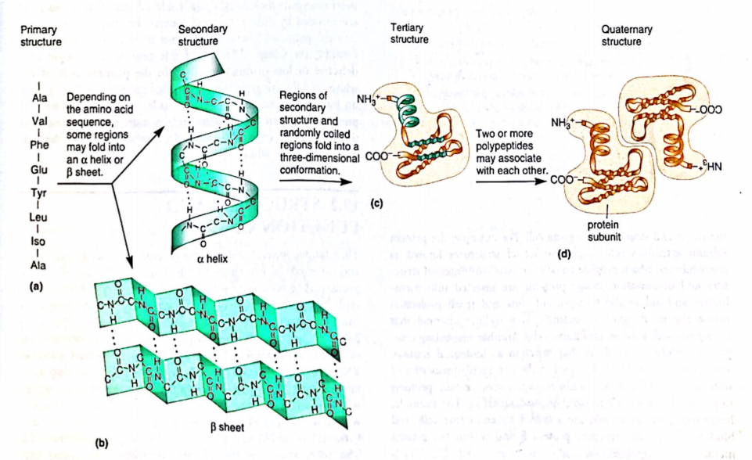
FIGURE 13.6 Levels of structures formed in proteins. (a) The primary structure of a polypeptide within a protein is its amino acid sequence.(b) Certain regions of a primary structure will fold into a secondary structure; the two types of secondary structures are called a helices and ß sheets.(c) Both of these secondary structures can be found within the tertiary structure of a polypeptide. (d) Some polypeptides associate with each other to form a protein with a quaternary structure.

Slide 21
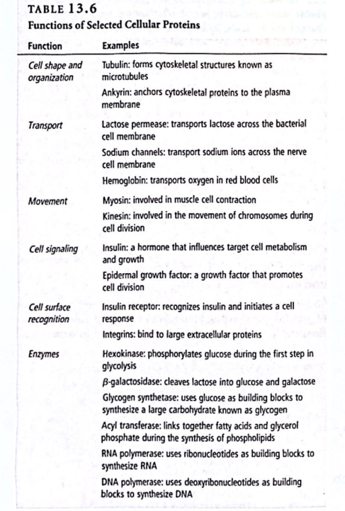
CELLULAR PROTEIN ARE PRIMARILY RESPONSIBLE FOR THE CHARACTERISTICS OF LIVING CELLS AND AN ORGANISM’S TRAITS

Slide 22
STRUCTURE AND FUNCTION OF tRNA
Translation Overview: The section discusses the molecular understanding of translation, specifically regarding tRNA's role in protein synthesis.
Historical Background: Studies on protein synthesis and tRNA began in the 1950s, leading to insights about amino acid incorporation into polypeptides.
Adaptor Hypothesis: Proposed by Francis Crick and Mahlon Hoagland, it suggests that:
tRNA determines the position of amino acids in a polypeptide by recognizing codons in mRNA.
Each tRNA serves two primary functions:
Codon Recognition: It recognizes a specific three-base codon sequence in mRNA.
Amino Acid Carrying: It carries the corresponding amino acid for that codon.
Critical Experiments: The text mentions important experiments that supported the adaptor hypothesis.
Structural Features of tRNA: The section indicates a discussion on the important structural characteristics of tRNA that facilitate its function in translation.

Slide 23
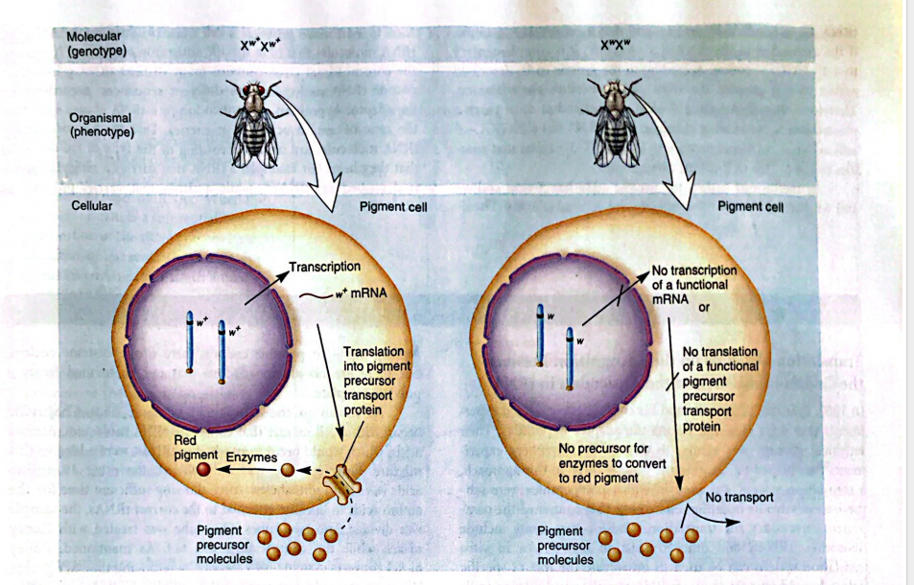
FIGURE 13.7 The figure illustrates the relationship between genes and traits across three biological levels: molecular, organismal, and cellular. It uses the example of eye color in fruit flies (Drosophila) to demonstrate how a specific gene influences a visible trait.

Slide 24
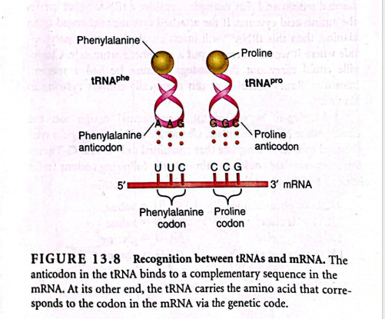
Function of a tRNA Depends on the Specificity Between the Amino Acid It Carries and Its Anticodon
tRNA and mRNA Interaction:
tRNA molecules recognize and bind to specific codons in mRNA during polypeptide synthesis.
Anticodon-Codon Binding:
The tRNA's anticodon pairs with a complementary codon in mRNA.
Example:
The anticodon 3'-AAG-5' in tRNA corresponds to the codon 5'-UUC-3' (which codes for phenylalanine).
The anticodon 3'-GGC-5' in tRNA corresponds to the codon 5'-CCG-3' (which codes for proline).

Slide 25
Function of a tRNA Depends on the Specificity Between the Amino Acid It Carries and Its Anticodon
Genetic Code:
There are 61 codons for 20 amino acids, plus 3 stop codons.
tRNA must carry the correct amino acid specified by its anticodon.
tRNA Genes:
Cells produce various tRNA molecules, each with a unique anticodon.
Distinct tRNA genes in chromosomal DNA encode these molecules.
Naming Convention:
tRNA molecules are named based on the amino acid they carry (e.g., tRNA^phe for phenylalanine, tRNA^pro for proline).

Slide 26
Common Structure: tRNAs have a standardized structure that facilitates their role in carrying the correct amino acids during translation.
Historical Context: The structure of tRNAs was proposed by Robert Holley in 1965.
Cloverleaf Secondary Structure: tRNAs feature a cloverleaf-shaped secondary structure characterized by:
Three stem-loop regions
A variable region
A 3' acceptor stem
4. Anticodon Function: The anticodon, located in the second stem loop, pairs with mRNA during translation.
5. Three-Dimensional Folding: Upon folding into their three-dimensional shapes, tRNAs become more compact and can contain modified nucleotides beyond the standard bases (A, U, G, C).
6. Nucleotide Modifications: Over 60 modifications of tRNA nucleotides have been identified, which influence codon recognition during translation.

Slide 27
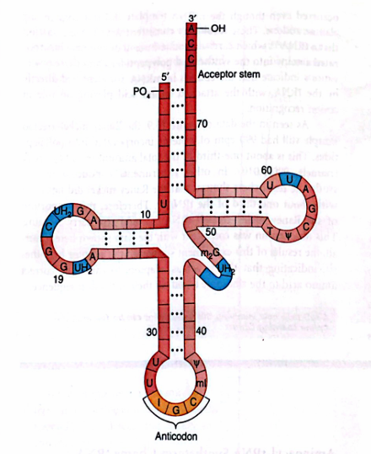
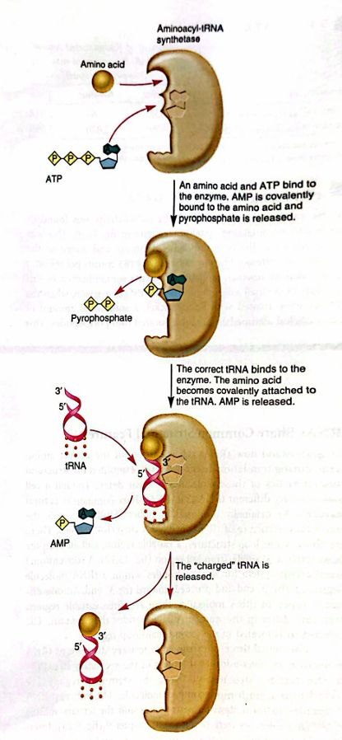
Figure 13.11 illustrates the function of aminoacyl-tRNA synthetase, which has binding sites for ATP, a specific amino acid, and tRNA. First, the enzyme attaches AMP from ATP to the amino acid, activating it. Next, the activated amino acid is linked to tRNA, enabling its transport to the ribosome for protein synthesis.
Figure 13.10 illustrates the tRNA secondary structure, showing the CCA sequence at the 3' end and variable nucleotide sites in blue. It also highlights modified bases in a yeast tRNA for alanine, including inosine (I), methylinosine (mI), ribothymidine (T), dihydrouridine (UH2), dimethylguanosine (m2G), and pseudouridine (Ψ).

Slide 28
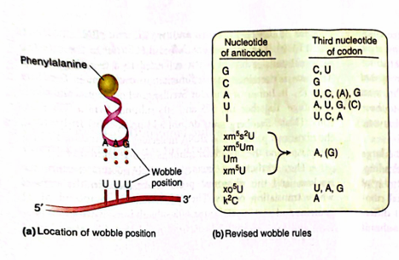
Wobble Position: This is where the first base of the tRNA anticodon pairs with the third base of the mRNA codon.
Revised Wobble Rules: Yokoyama and Nishimura (1995) updated the original wobble rules by Crick.
Standard RNA Bases: The common bases in RNA are Guanine (G), Cytosine (C), Adenine (A), and Uracil (U).
Modified tRNA Bases: Some tRNA bases can be modified at the wobble position, including:
Inosine (I)
5-methyl-2-thiouridine (xm^s2U)
5-methyl-uridine (xm^5U)
2'-O-methyluridine (xm^Um)
5-hydroxyuridine (xo^5U)
Lysidine (k^2C)
5. Translation Efficiency: The weak pairing of mRNA bases affects how efficiently proteins are made during translation.
Figure 13.12

Slide 29
Ribosome Structure and Assembly
tRNAs bind to mRNA by matching their anticodons to mRNA codons, carrying the appropriate amino acid on their 3' end. To form a protein, the bond between the tRNA and amino acid breaks, allowing amino acids to link together on the ribosome, the site of protein synthesis.
Bacterial Ribosomes
Type
Bacterial cells contain a single type of ribosome located in the cytoplasm.
Structure
Composed of a small 30S subunit (21 proteins, 1 rRNA) and a large 50S subunit (34 proteins, 2 rRNAs).
Total composition forms a 70S ribosome.
Eukaryotic Ribosomes
Location
Eukaryotic cells have various ribosomes in different cell parts, primarily in the cytosol, and in organelles like mitochondria and chloroplasts.
Structure
The small 40S subunit (33 proteins, 1 18S rRNA) and large 60S subunit (49 proteins, 3 rRNAs: 5S, 5.8S, and 28S) combine to form an 80S ribosome.
Ribosomal subunits are assembled in the nucleolus and exported to the cytosol for translation.

Slide 30
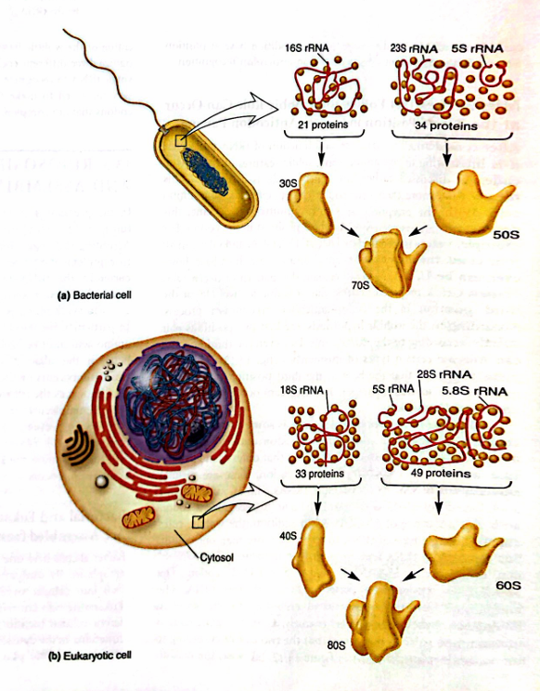
Figure 13.13 compares bacterial and eukaryotic ribosomes:
(a) Bacterial ribosomes have two subunits: the 30S and 50S. The 30S subunit is made of 21 proteins and one rRNA, while the 50S subunit contains 34 proteins and two rRNAs (5S and 23S).
(b) Eukaryotic ribosomes, found in the cytosol, also have two subunits: the 40S and 60S. The 40S subunit has 33 proteins and one rRNA (18S), and the 60S subunit has 49 proteins and three rRNAs (5S, 5.8S, and 28S). The 40S and 60S subunits are assembled in the nucleolus and then transported to the cytosol for translation.

Slide 31
Components of Ribosomal Subunits in Translation
Research Advances: Significant progress has been made in understanding ribosome structure and function through advanced microscopy and biophysical techniques, including crystallization of ribosomal subunits and entire ribosomes.
rRNA's Role: Ribosomal shape and mass are primarily determined by ribosomal RNA (rRNA), which forms the bulk of the ribosome.
mRNA Binding: In bacteria, mRNA attaches to the surface of the 30S subunit, while the polypeptide exits through a channel in the 50S subunit.
tRNA Binding Sites: Ribosomes have specific sites for tRNA binding and polypeptide synthesis, essential for the translation process.
Two-Site Model: James Watson proposed a two-site model in 1964, later expanded by Knud Nierhaus and Hans-Jorg Rheinberger in 1984 to include an exit (E) site for releasing uncharged tRNAs.
A, P, and E Sites: The A (aminoacyl), P (peptidyl), and E (exit) sites are crucial for translation, facilitating the binding and movement of tRNA and the synthesis of polypeptides.

Slide 32
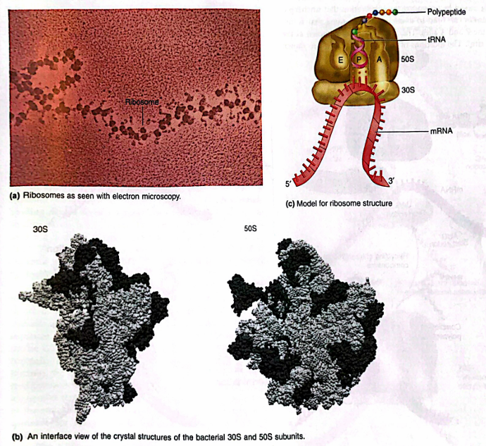
The translation process, like transcription, happens in three stages: initiation, elongation, and termination.
Initiation: The mRNA, initiator tRNA (which binds to the start codon), and ribosomal subunits come together to form a complex.
Elongation: After the complex forms, the ribosome moves along the mRNA from the 5' to 3' direction. As it moves, tRNA molecules bind to the mRNA at the ribosome’s A site, bringing amino acids. These amino acids are linked in the sequence determined by the mRNA codons.
Termination: When the ribosome reaches a stop codon, the process ends. The complex breaks apart, and the newly made polypeptide (protein) is released.
The A, P, and E sites are crucial for translation. Figure 13.14 illustrates ribosomal structure:
(a) An electron micrograph shows ribosomes on an mRNA molecule.
(b) The crystal structure of bacterial 30S and 50S subunits, highlighting the rRNA-protein interface.
(c) A model showing tRNA and mRNA binding locations, with the growing polypeptide chain exiting through the 50S channel.
To visualize the relationship between the crystal structures and the intact ribosome, place your hands, palms up, on a desk to represent the interfaces of the ribosomal subunits. Bringing your palms together corresponds to the model when rotated 90 degrees clockwise, with the A, P, and E sites in the cavity between your hands.

Slide 33
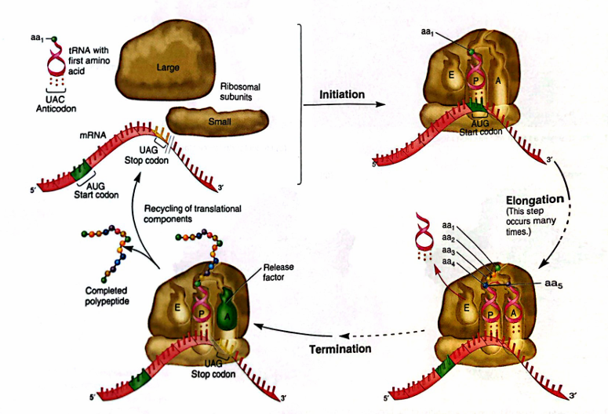
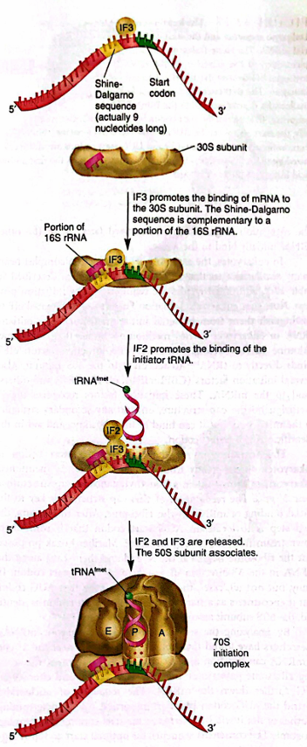
Figure 13.16 explains the process of translational initiation in bacteria:
IF3 helps the mRNA bind to the 30S ribosomal subunit.
The Shine-Dalgarno sequence on the mRNA forms hydrogen bonds with part of the 16S rRNA in the 30S subunit.
IF2 then binds to the initiator tRNA, which attaches to the start codon located at the P site of the ribosome.
Afterward, IF2 and IF3 are released, allowing the 50S ribosomal subunit to join the 30S subunit, forming the 70S initiation complex. This completes the initiation stage of bacterial translation.
Figure 13.15 illustrates the three stages of translation:
Initiation: Ribosomal subunits, mRNA, and tRNA assemble with the first amino acid.
Elongation: The ribosome moves along mRNA, linking amino acids to form a polypeptide chain.
Termination: Translation ends when the ribosome encounters a stop codon, releasing the polypeptide.

Slide 34
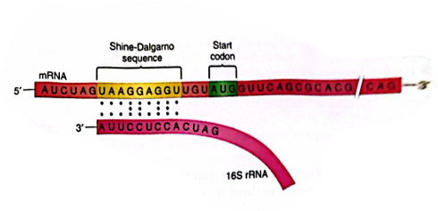
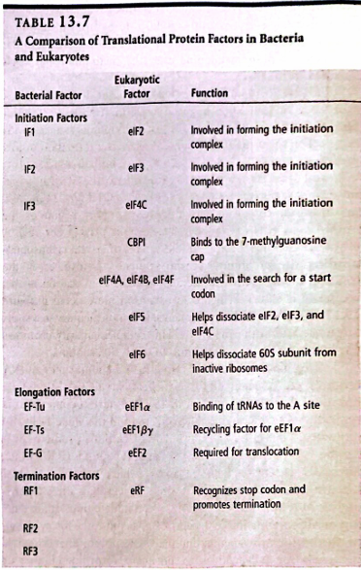
Figure 13.17 shows the positions of the Shine-Dalgarno sequence and the start codon in bacterial mRNA:
The Shine-Dalgarno sequence is complementary to a sequence in the 16S rRNA and forms hydrogen bonds with it, promoting the initiation of translation.
The start codon (usually AUG) is located a few nucleotides downstream from the Shine-Dalgarno sequence.
Occasionally, the start codon can be GUG (for valine) or UUG (for leucine), but in these cases, they are still recognized by tRNAfmet, resulting in formylmethionine being the first amino acid instead of valine or leucine.

Slide 35
Polypeptide Synthesis During Elongation
During the elongation stage of translation, amino acids are added one by one to a growing polypeptide chain. This process is fast—up to 15-18 amino acids per second in bacteria and 6 per second in eukaryotes.
Here’s how it works:
A tRNA brings a new amino acid to the ribosome and binds to the A site (because its anticodon matches the codon in the mRNA).
Energy from GTP helps this tRNA bind to the A site.
If the tRNA is incorrect, the ribosome's 16S rRNA detects the error and stops the process until the wrong tRNA is released (this is the ribosome’s decoding function).
A peptide bond forms between the new amino acid at the A site and the growing polypeptide chain at the P site (a reaction called peptidyl transfer).
The ribosome shifts to the next codon, moving the tRNAs to the E and P sites, and the uncharged tRNA exits the E site.
A new charged tRNA enters the A site, and the process repeats to build the polypeptide chain.

Slide 36
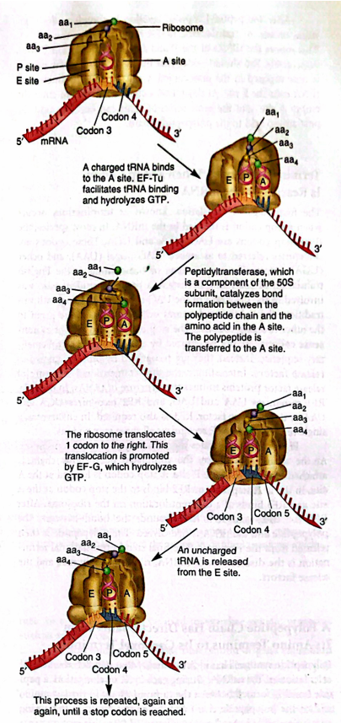
Figure 13.18: Elongation Stage of Translation in Bacteria
tRNA Binding: The elongation stage begins when a new tRNA enters the A site of the ribosome. This process requires energy from GTP hydrolysis via the protein EF-Tu.
Peptide Bond Formation: A peptide bond is formed between the amino acid on the new tRNA and the last amino acid in the growing polypeptide chain. This shifts the polypeptide chain to the A site.
Translocation: The ribosome then moves in the 3' direction, causing the tRNAs to shift to the E (exit) and P (peptidyl) sites. This movement, known as translocation, is powered by GTP hydrolysis via EF-G.
tRNA Release: The uncharged tRNA in the E site is released from the ribosome, making it ready for the next cycle.
Cycle Continuation: Each elongation cycle adds one amino acid to the growing polypeptide chain.

Slide 37
Termination of Translation
Termination is the final stage of translation, which occurs when the ribosome reaches a stop codon (UAG, UAA, or UGA) in the mRNA.
Stop Codons: These codons are not recognized by tRNA but by proteins known as release factors.
In bacteria:
RF1 recognizes UAA and UAG.
RF2 recognizes UGA.
RF3 assists both.
In eukaryotes:
A single release factor, eRF, recognizes all stop codons.
Release of Polypeptide: When the release factor binds to the stop codon, the polypeptide chain is released from the ribosome.
Disassembly: The ribosomal components then disassemble, marking the end of translation.
A Polypeptide Chain Has Directionality from Its Amino Terminus to Its Carboxyl Terminus
A polypeptide chain has directionality, extending from the amino (N-terminal) end to the carboxyl (C-terminal) end, similar to how mRNA is read from 5' to 3’.
During elongation, a peptide bond forms between the carboxyl group of the last amino acid and the amino group of the new amino acid, releasing a water molecule.
The first amino acid has a free amino group (N-terminal), and the last amino acid has a free carboxyl group (C-terminal).
This directional growth continues as the polypeptide is synthesized.

Slide 38
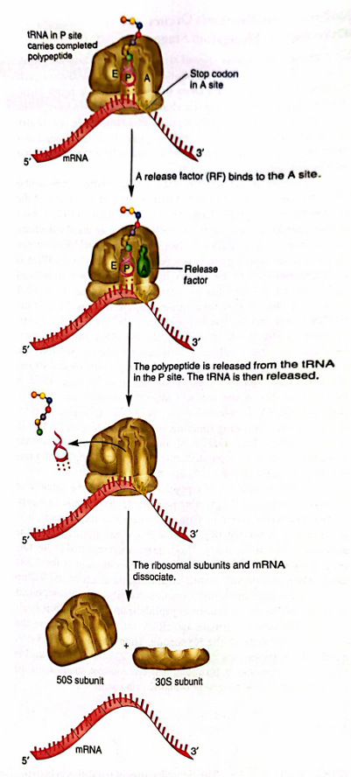
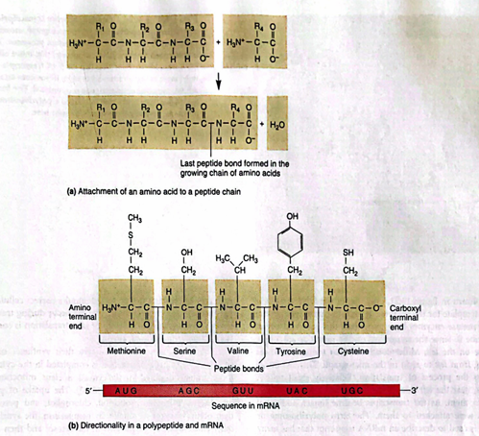

Figure 13.19 When a stop codon reaches the A site, release factors RF1 or RF2 bind to it.RF3 helps in this process by using GTP. The polypeptide is cleaved from the tRNA in the P site and released. Finally, the tRNA and other components disassemble, completing translation.
Figure 13.20 Directionality of Polypeptide Synthesis
Part (a): An amino acid is added to the growing polypeptide chain through a condensation reaction, which releases a water molecule.
Part (b): The first amino acid, usually methionine, is at the amino (N) terminus, and the last amino acid is at the carboxyl (C) terminus.
This directionality from the N terminus to the C terminus matches the 5' to 3' orientation of codons in the mRNA.

Slide 39
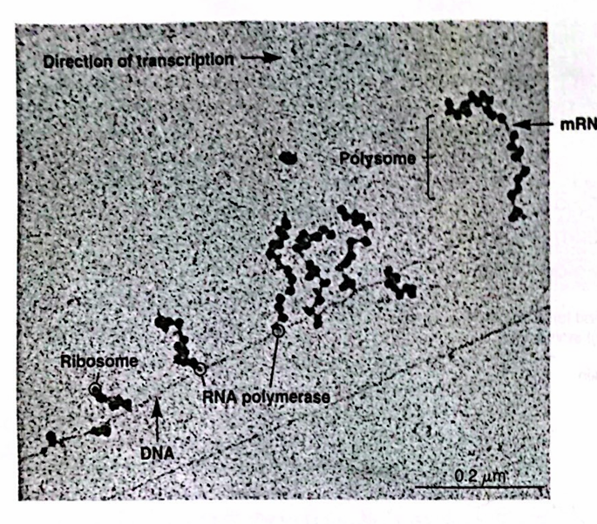
Bacterial Translation and Coupling
Simultaneous Processes: In bacteria, translation can start before transcription is finished.
Ribosome Attachment: Ribosomes attach to the 5' end of the mRNA as soon as it's long enough, translating it into protein while RNA polymerase continues transcribing the gene.
This simultaneous process is known as coupling.
Historical Observation: Coupling was first observed in 1967 by Oscar Miller Jr. and his team using electron microscopy.
Scientific Importance: This technique has been crucial for visualizing gene expression and understanding transcription and translation.
Figure 13.21
Coupling of Transcription and Translation in Bacteria
Electron Micrograph: The image shows DNA being transcribed by multiple RNA polymerases moving from left to right, resulting in longer RNA transcripts.
Early Translation: Ribosomes attach to the mRNA and begin translation even before transcription is complete.
Polyribosomes: When several ribosomes are bound to the same mRNA, this formation is known as a polyribosome or polysome. The image reveals multiple polyribosomes.

Slide 40
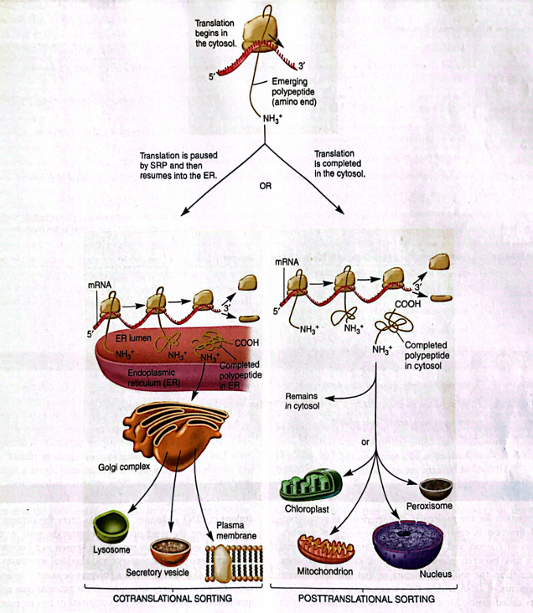
Amino Acid Sequences and Sorting Signals in Proteins
Sorting Signals: Proteins contain specific amino acid sequences that direct them to their proper cellular locations.
Bacterial Proteins: Some proteins are tagged for secretion outside the cytoplasm.
Eukaryotic Proteins: Sorting is complex due to organelles. For instance, ATP-synthase is in mitochondria, while actin is in the cytosol.
Sorting Mechanisms:
Posttranslational Sorting: Most proteins begin synthesis in the cytosol and are sorted afterward.
Cotranslational Import: Proteins destined for the endoplasmic reticulum (ER) have synthesis paused while the ribosome attaches to the ER.
Function of Sorting Signals: These short amino acid sequences ensure proteins reach their correct locations for proper function.

Slide 41
Thanks!
Do you have any questions?
youremail@freepik.com
+34 654 321 432
yourwebsite.com
Please keep this slide for attribution

